Slide 1
EBAY Shopping Website Automation Testing
By Yugandhar Muppana
Under The Guidance Of Mrs. Vaishali Sonanis Mam

Slide 2
Introduction
eBay is a worldwide online marketplace that connects buyers and sellers, providing a platform for trading both new and pre-owned items.
It allows individuals and businesses to list products for auctions or fixed-price sales, fostering a diverse e-commerce ecosystem.
With millions of listings across various categories, eBay makes it easy to shop, sell, and explore unique products.

Slide 3
Overview
Our eBay Demo Experience
This demo highlights how eBay’s platform operates for both buyers and sellers.
It guides users through the buying, selling, and auction features while showcasing how listings are displayed, orders are managed, and the seller dashboard works.
Why Use eBay? Start your online selling journey with ease list products quickly, reach millions of buyers, and grow with eBay’s trusted e-commerce marketplace.
This demo offers a real-world preview of the platform, helping sellers envision the potential of their online store.

Slide 4
Modules
MODULE 1: SIGN-IN PAGE
Objective: To check the Functionalities of eBay's login system
MODULE 2: MULTIPLE SEARCHES
Objective: To validate the accuracy and efficiency of eBay’s search functionality.
MODULE 3: ADD TO CART
Objective: To Validate the cart functionality for a smooth shopping experience.
MODULE 4: REMOVE FROM CART
Objective: To confirm that users can easily modify their cart.

Slide 5
Modules
MODULE 5: UPDATE USERNAME (ACCOUNT SETTINGS)
Objective: To Validate the feature to modify the user's display name.
MODULE 6: UPDATE ADDRESS (ACCOUNT SETTINGS)
Objective: To Verify address modification in user profile.
MODULE 7: SHOP BY CATEGORY
Objective: To test product browsing through category navigation.
MODULE 8: SHOP BY ALL CATEGORIES (DROPDOWN)
Objective: To validate the functionality of "All Categories" dropdown filter.

Slide 6
Modules
MODULE 9: FOOTER LINKS
Objective: To verify the footer navigation links.
MODULE 10: LOGOUT FUNCTIONALITY
Objective: To ensure secure and proper termination of user sessions.

Slide 7
Defects
During the execution of test cases, certain fields did not function as expected, indicating defects. I have documented these issues in a Defect Report.
Defects are :
The "Include Description" checkbox in the advanced search filter does not affect the search results when selected; the results remain the same as a title-only search.
When hovering over the “Deals element”, no popup appears, whereas other elements display their respective categories.

Slide 8
Defect identifier :- B_001
Defect summary :- The "include description" checkbox in the advanced search filter does not update or change the search results when checked. The results remain identical to A title-only search.
Test Id :- TC_001
Test case name :- TC_Search_Include_Description_Functionality
Module name :- Search & Filtering
Reproducible :-
Severity :- Low
Priority :- Low
Raised by :- Yugandhar Muppana
Assigned to :- Developer Team Lead
Ø Date of assignment :- 18/08/2025
Ø Status :- Pending
Ø Snap shots :- Added Below
Ø Fixed by :- Developer
Ø Date of fixing :-

Slide 9
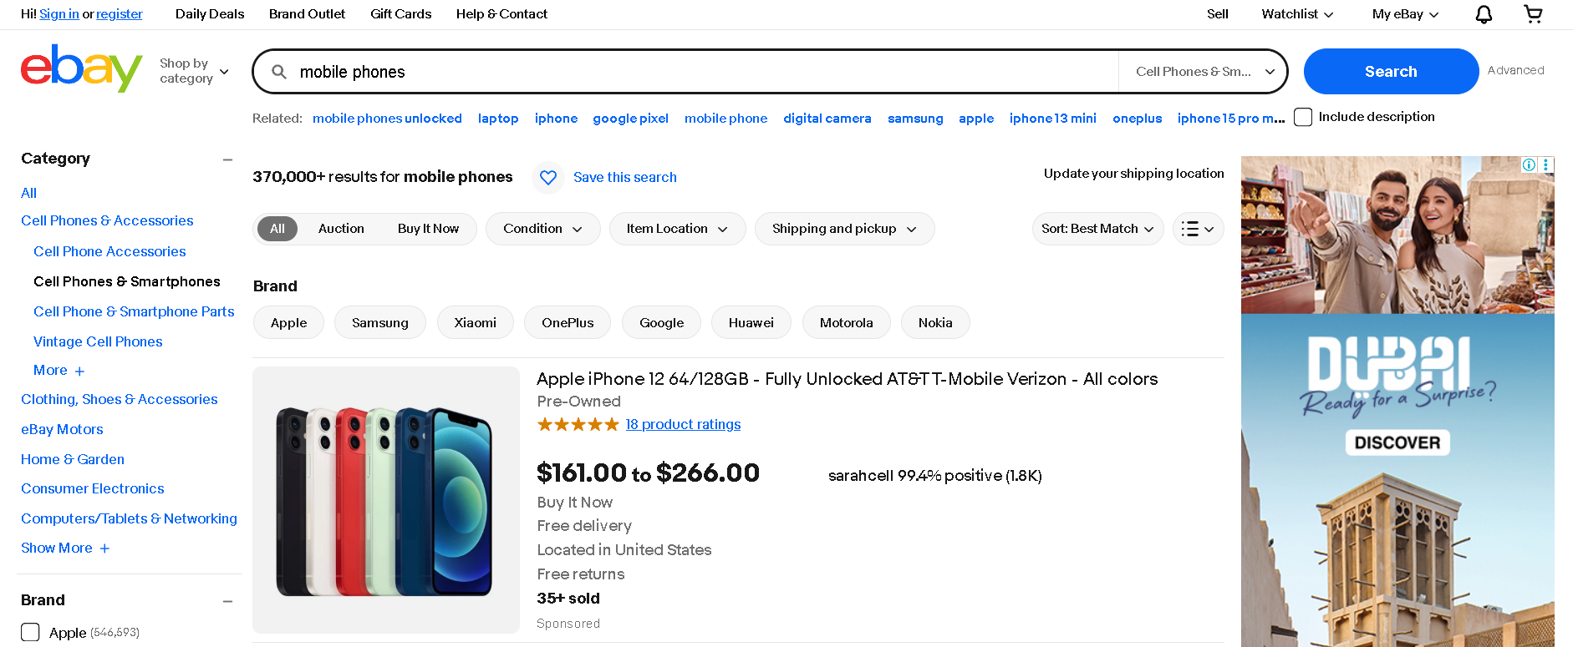
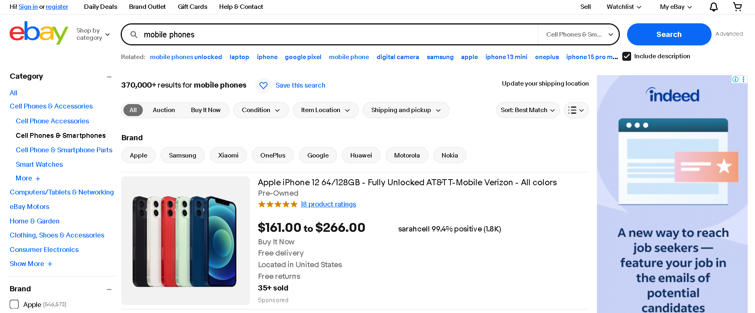

Slide 10
Defect identifier :- B_002
Defect summary :- When hovering over the “Deals element”, no popup appears, whereas other elements display their respective categories.
Test Id :- TC_002
Test case name :- TC_Hovering_Deals_Element
Module name :- Deals Button
Reproducible :-
Severity :- Medium
Priority :- Medium
Raised by :- Yugandhar Muppana
Assigned to :- Developer Team Lead
Ø Date of assignment :- 18/08/2025
Ø Status :- Pending
Ø Snap shots :- Added Below
Ø Fixed by :- Developer
Ø Date of fixing :-

Slide 11
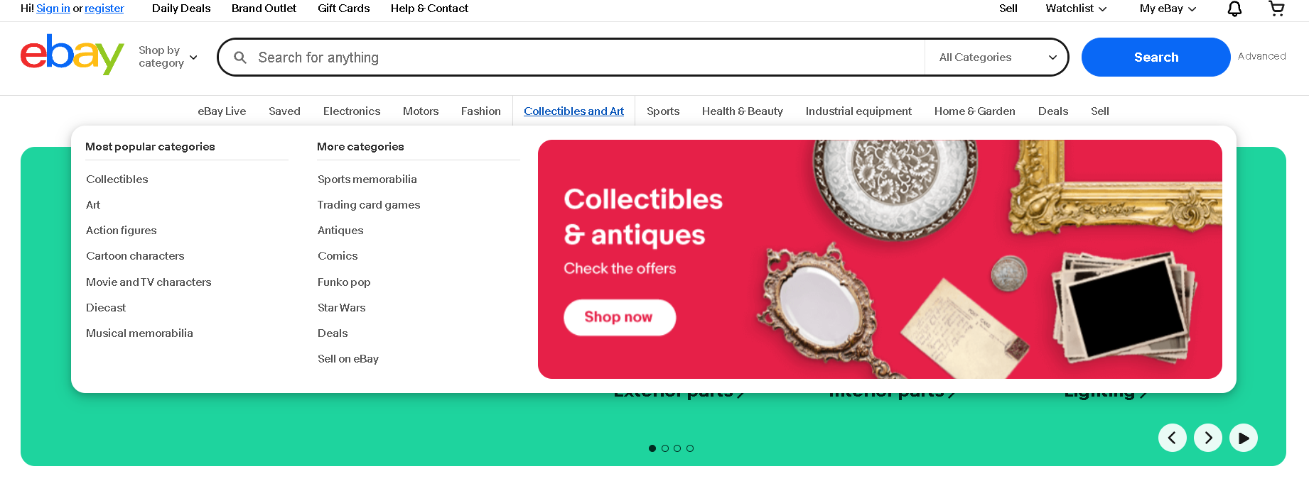
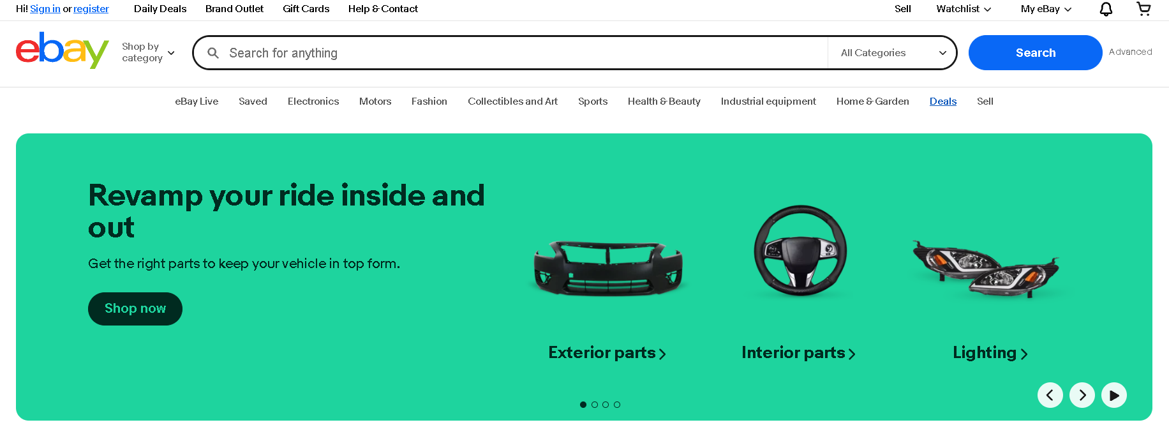

Slide 12
Challenges
Handling the entire scope of testing for a large-scale website like eBay alone was a significant challenge, requiring careful time management.
Random test failures caused by slow page loads.
CAPTCHA / verification steps disrupting the automation flow.

Slide 13
Experience
Worked with real-world scenarios like profile updates and address modifications.
I stopped looking at the website as a user and started looking at it as a tester.
Gained experience in testing both frontend UI elements and backend functionality.
Learned to handle test failures.

Slide 14
Thank You !

